Slide 1
Excel darba lapas atvēršana lietošanai DBVS-ā MS Access
Sub ADOOpenISAMDatabase()
Dim cnn As New ADODB.Connection
cnn.Open "Provider=Microsoft.Jet.OLEDB.4.0;" & _
"Data Source=G:\Eiduks\DBVS\Darbinieki.xls" & _
";Extended Properties=Excel 8.0;"
Dim rst As New ADODB.Recordset
rst.Open "SELECT * FROM Tabula_1", _
cnn, adOpenKeyset, adLockOptimistic
Debug.Print rst!UZV
cnn.Close
End Sub

Slide 2
Exended Properties
Datubāze | Norādāmā vērtība
dBASE III | dBASE III;
dBASE IV | dBASE IV;
dBASE 5 | dBASE 5.0;
Paradox 3.x | Paradox 3.x;
Paradox 4.x | Paradox 4.x;
Paradox 5.x | Paradox 5.x;
Excel 3.0 | Excel 3.0;
Excel 4.0 | Excel 4.0;
Excel 5.0/Excel 95 | Excel 5.0;
Excel 97 | Excel 97;
Excel 2000 | Excel 8.0;
HTML Import | HTML Import;
HTML Export | HTML Export;
Text | Text;
ODBC | ODBC; DATABASE=database; UID=user; PWD=password; DSN=datasourcename;

Slide 3
Svarīgākās no objekta Recordset īpašībām
AbsolutePosition — Tekošā ieraksta numurs
ActiveConnection — Norāda aktīvo savienojumu ar datu avotu
BOF — Nosaka, vai tekošā ieraksta pozīcija atrodas pirms pirmā ieraksta
EOF — Nosaka, vai tekošā ieraksta pozīcija atrodas aiz pēdējā ieraksta
Bookmark — Ieliktnis, ar kura palīdzību iespējams identificēt katru ierakstu
CursorLocation — Nosaka kursoru atrašanās vietu
CursorType — Nosaka kursora tipu
EditMode — Nosaka tekošā ieraksta modificēšanas iespējas
Filter — Definē filtru
MaxRecords — Nosaka maksimālo ierakstu skaitu
RecordCount — Ieraktu skaits
Sort — Definē vienu vai vairākus laukus, pēc kuriem ieraksti tiek šķiroti
Source — Nosaka objekta datu avotu

Slide 4
Svarīgākās no objekta Recordset metodēm
Jauna ieraksta pievienošana — AddNew
Atceļ izdarītās izmaiņas — Cancel
Izveido objekta dublikātu — Clone
Tekošā ieraksta vai ierakstu grupas dzēšana — Delete
Tekošā ieraksta modificēšana — Edit
Tekošā ieraksta pozīcijas maiņa — Move, MoveFirst, MoveLast, MoveNext, MovePrevious
Tiek atvērts kursors — Open
Objekta satura atjaunināšana, atkārtojot bāzes vaicājuma izpildi — Requery
Saglabā objekta saturu failā — Save
Objekta indeksa pārmeklēšana — Seek
Izdarīto ieraksta izmaiņu saglabāšana objektā — Update
Veic izdarīto izmaiņu saglabāšanu pakotnes veidā — UpdateBatch

Slide 5
Svarīgākās no objekta Field īpašībām
Lauka faktiskais garums — ActualSize
Lauka definētais garums — DefinedSize
Lauka vērtība pirms izmaiņu izdarīšanas — OriginalValue
Lauka tips — Type
Lauka vērtība — UnderlyingValue

Slide 6
Svarīgākās no objekta Error īpašībām
Kļūdas apraksts — Description
Kļūdas numurs — Number
Objekts vai lietojums, kas ģenerējis kļūdu — Source

Slide 7
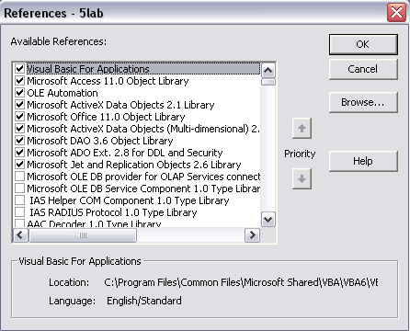
ADO un DAO lietošanai nepieciešamās bibliotēkas

Slide 8
Failu atvēršana
Public Sub Browse_button()
Dim dialog As FileDialog
‘izveidots Mainīgais ar tipu FileDialog no bibliotēkas „Microsoft Office 11.0 Object Library”, kas atver faila atvēršanas dialoga logu
Dim i As Integer
Dim j As Integer
Set dialog = Application.FileDialog(msoFileDialogOpen)
‘Dialogam piešķitam failu atvēršanas dialoga tipu
dialog.Filters.clear
‘dzēšam visus filtrus, kuri atpazīst failu veidu pēc faila paplašinājuma
dialog.AllowMultiSelect = False
dialog.Title = "Open File..."

Slide 9
dialog.Filters.Add "All files", "*.mdb; *.xls", 1
‘Kā pamata filtrs tiek izveidots filtrs – All files. Šis filtrs atpazīst tikai *.mdb un *.xls failus
dialog.Filters.Add "MS Excel book", "*.xls", 2
‘Tiek izveidots filtrs, kurš atpazīst tikai *.xls failus
dialog.Filters.Add "MS Access database", "*.mdb", 3
‘Tiek izveidots filtrs, kurš atpazīst tikai *.mdb failus
dialog.FilterIndex = 1
‘pēc noklusējuma tiek uzstādīts pirmais filtrs (All files)
Forms("mainForm").path.Enabled = True
If dialog.Show = -1 Then
Forms("mainForm").path = dialog.FilterIndex
‘teksta laukam ‘path’ piešķiram vērtību, kas ir vienāda ar izvelēta filtra numuru

Slide 10
Forms("mainForm").path.SetFocus
Forms("mainForm")!path = dialog.SelectedItems(1)
‘Piešķiram teksta laukam ‘path’ pilnu ceļu uz failu
Forms("mainForm").controls("refresh").Enabled = True
End If
End Sub

Slide 11
ADO X objektu hierarhija
Catalog
  Tables – Table - {Columns, Indexes, Keys)
  Groups – Group – Users - User
  Users - User – Groups - Group
  Procedures – Procedure – Command
  Views - View - Command

Slide 12
Tabulu metadatu izgūšana (tabulu kolonas)
Private Sub tab_comboBOX()
Dim savienojums As ADODB.Connection
Set savienojums = New ADODB.Connection
Dim mn1, mn2 As String
mn1 = Forms("Galvena izvelne").Controls("gadnieks").Value
mn2 = Forms("Galvena izvelne").Controls("vieta").Value
Dim teksts As String
teksts = "Provider = " & mn1 & "Data Source =" & mn2 _
& mn3
savienojums.ConnectionString = teksts
savienojums.Open

Slide 13
Dim Cat As ADOX.Catalog
Set Cat = New ADOX.Catalog
Set Cat.ActiveConnection = savienojums
Dim i As Integer
For i = 0 To Cat.Tables(TabName).Columns.Count - 1
Forms("Galvena izvelne").Controls("kolonnas_list").AddItem Cat.Tables(TabName).Columns(i).Name
Next i
Set savienojums = Nothing
End Sub

Slide 14
Tabulu metadatu izgūšana (tabulas)
Private Sub Command13_Click()
Dim mn1, mn2 As String
mn1 = Forms("Galvena izvelne").Controls("gadnieks").Value
mn2 = Forms("Galvena izvelne").Controls("vieta").Value
Dim savienojums_1 As ADODB.Connection
Set savienojums_1 = New ADODB.Connection
Dim teksts As String
teksts = "Provider = " & mn1 & "Data Source =" & mn2
savienojums_1.ConnectionString = teksts
savienojums_1.Open

Slide 15
Dim Catalog As ADOX.Catalog
Set Catalog = New ADOX.Catalog
Set Catalog.ActiveConnection = savienojums_1
Dim i As Integer
For i = 0 To Catalog.Tables.Count - 1
If Catalog.Tables.Item(i).Type = "TABLE" Then
Forms("Galvena izvelne").Controls("tabulas_combo").AddItem Item:=Catalog.Tables.Item(i).Name
End If
Next i
Set savienojums_1 = Nothing
End Sub

Slide 16
MS Access projektu veidošana

Slide 17
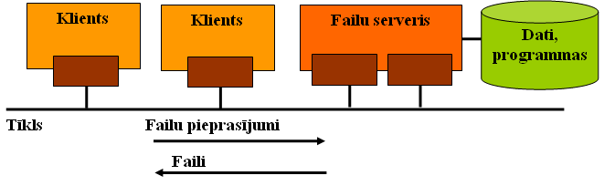
Informācijas sistēmu ar datu bāzēm arhitektūras (1)
Failu servera arhitektūra

Slide 18
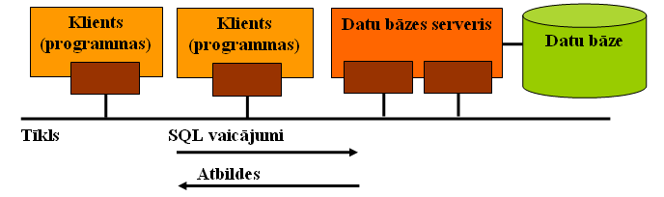
Informācijas sistēmu ar datu bāzēm arhitektūras (2)
Datu bāzes servera jeb SQL servera arhitektūra

Slide 19
What is a Microsoft Access Project?
A Microsoft Access project (.adp) is a new type of Access file that provides efficient, native-mode access to a Microsoft SQL Server database through the OLE DB component architecture.
Using an Access project, you can create a client/server application as easily as a file server application.
This client/server application can be a traditional solution based on forms and reports, or a Web-based solution by using data access pages, or a combination of both.

Slide 20
MS Access projekts
Datu bāze (datu objekti)
Datu bāze – projekts (lietojuma objekti: formas, pārskati, u.c.)

Slide 21
Access project
An Access project is called a project because it contains only code-based or HTML-based database objects: forms, reports, data access pages, macros, and modules. These are the database objects that you use to create an application.
Unlike a Microsoft Access database, an Access project does not contain any data or data definition based objects: tables, views, database diagrams, or stored procedures (which can also contain application code). Instead, these database objects are stored in the SQL Server database.

Slide 22
Izmantojot MS Access projektu var pieslēgties
Microsoft SQL Server 6.5;
Microsoft SQL Server 7.0;
Microsoft SQL Server 2000;
Microsoft SQL Server 2002;
Microsoft Data Engine (MSDE) database.

Slide 23
MSDE
If you are using MSDE on a personal computer:
  the default server name is the name of your computer;
  and the default logon ID is “sa”.
MSDE (MS Data Engine) is a new technology that provides local data storage that is compatible with Microsoft SQL Server 7.0. You can also use MSDE as a remote data storage solution.
Think of MSDE as a client/server data engine alternative to the file server Microsoft Jet database engine. MSDE runs under Microsoft Windows NT 4.0 or later and Windows 95 or later.
Because MSDE is based on the same data engine as SQL Server, most Microsoft Access projects or client/server applications run on either version unchanged. However unlike SQL Server 7.0, MSDE has a 2 gigabyte database size limit, doesn't support Symmetrical Multiprocessing (SMP) on Windows 95 or later.

Slide 24
Using MSDE as desktop database alternative to a MS Access
1) As a small workgroup server database.
You develop your applications by using an Access project connected to MSDE. You anticipate that your workgroup and its business requirements may grow over time until they eventually need the full functionality of SQL Server 7.0 running on a larger network server.
2) As a replication subscriber
in an SQL Server replicated database environment. For example, you may have mobile users working remotely from the main office who access and update MSDE on laptops or disconnected computers, but then periodically connect to the Master SQL Server database to reconcile changes.
3) To easily develop and test an Access project or client/server application
on a personal computer or workstation, and then modify the Access project connection information to connect to an SQL Server database on a remote server for final testing and production.

Slide 25
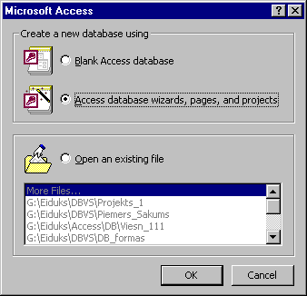
MSDBE izmantošana
Instalēšana: Setupsql.exe \Sql\x86\Setup

Slide 26
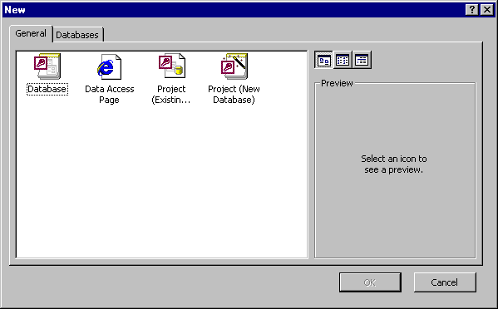

Slide 27
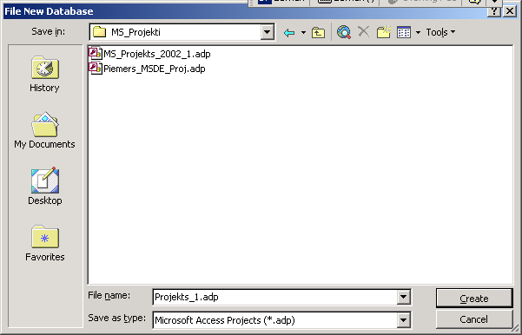

Slide 28
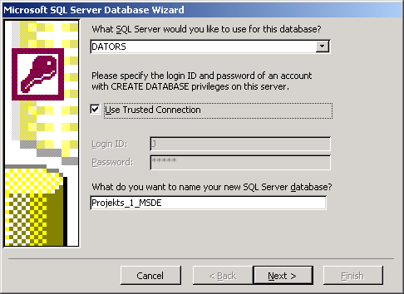
Jaunas datu bāzes veidošanas izmantojot palīgu (wizard)

Slide 29
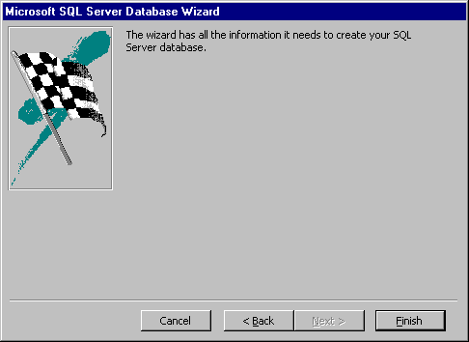

Slide 30
Once you connect to an SQL Server database, you can view, create, modify, and delete tables, views, stored procedures, and database diagrams by using the Microsoft SQL Server Design Tools, the same design tools that are used in Microsoft Visual Interdev and Microsoft Visual Basic.
An Access project also contains many of the same wizards as an Access database, such as the Form Wizard, the Report Wizard, and the Page Wizard, which you can use to quickly create a prototype or simple application.

Slide 31
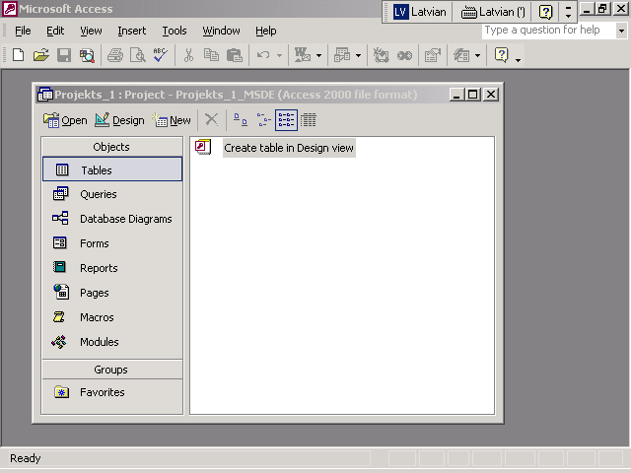
MSDBE DBVS galvenais vadības logs

Slide 32
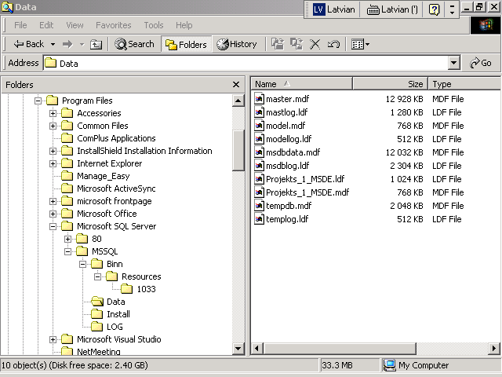
MSDBE datu bāzes faili

Slide 33
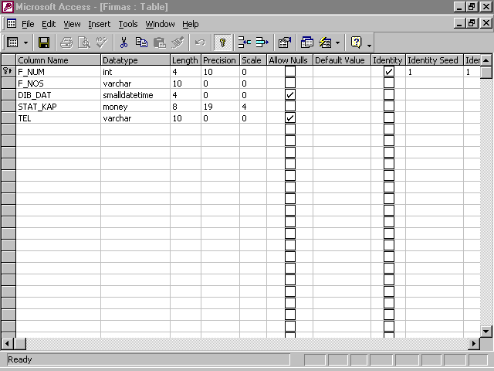
Tabulas veidošana

Slide 34
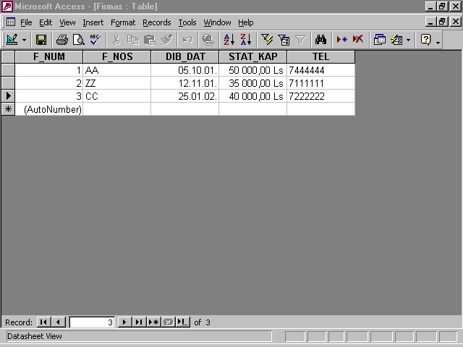

Slide 35
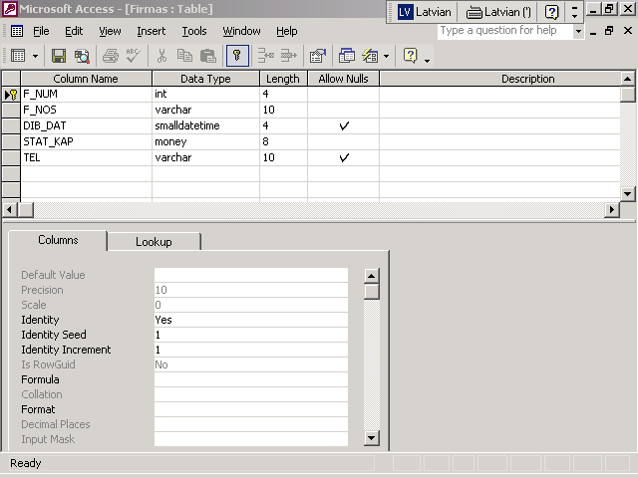

Slide 36
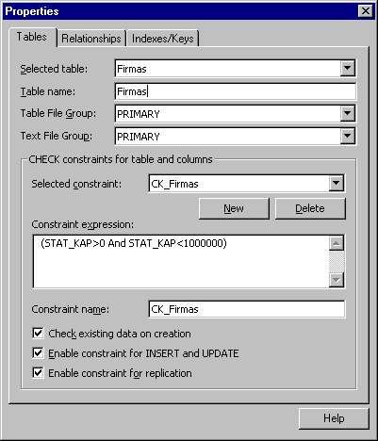
Tabulas īpašības

Slide 37
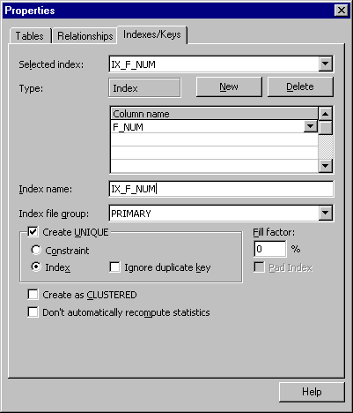

Slide 38
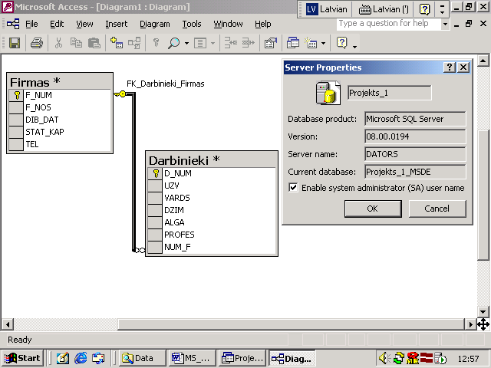
Database Diagrams

Slide 39
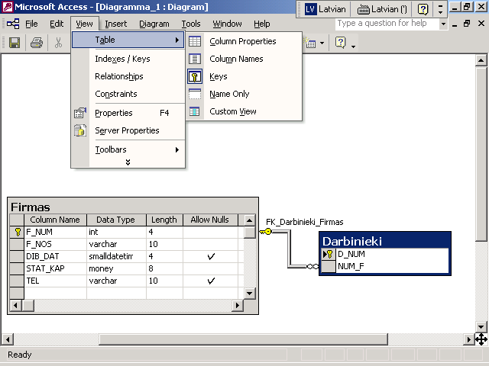

Slide 40
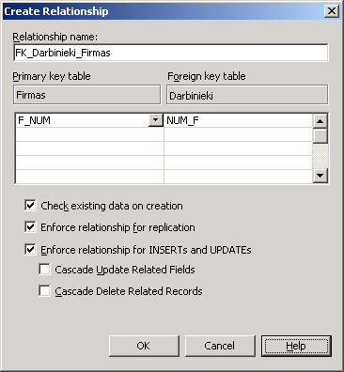

Slide 41
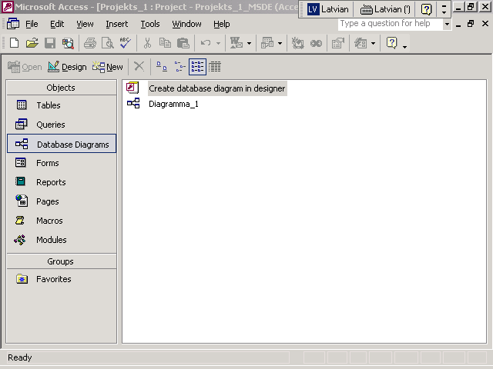

Slide 42
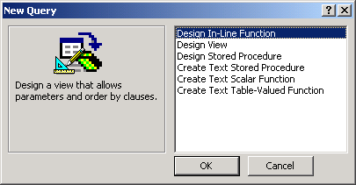
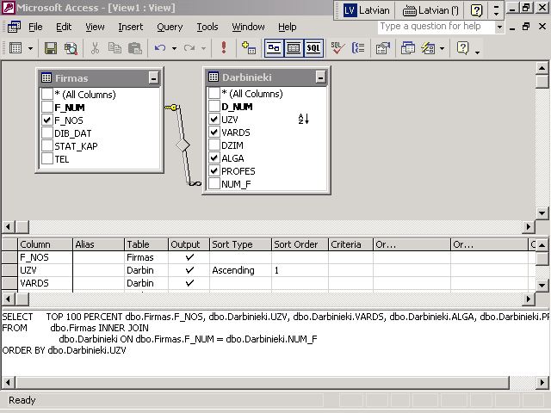
Vaicājumi

Slide 43
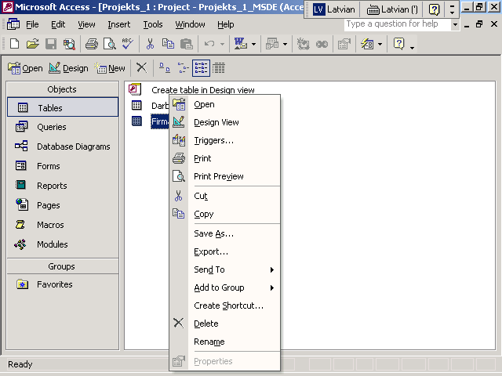

Slide 44
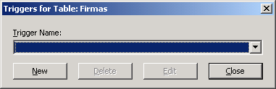
Trigeri
CREATE TRIGGER Firmas_Trigger1 ON dbo.Firmas
FOR /* INSERT, UPDATE, DELETE */
AS
/* IF UPDATE (column_name) ...*/

Slide 45
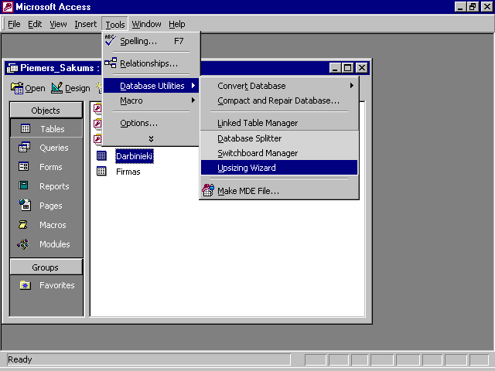
Database Upsizing

Slide 46
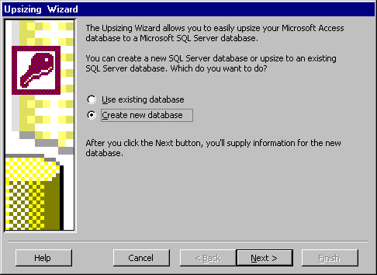
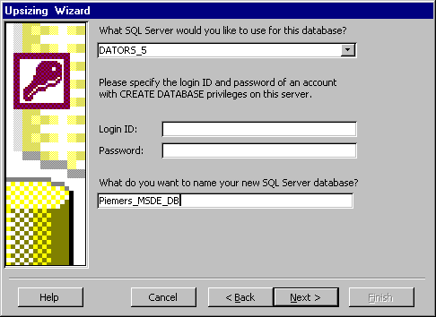

Slide 47
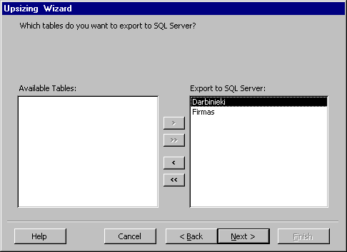
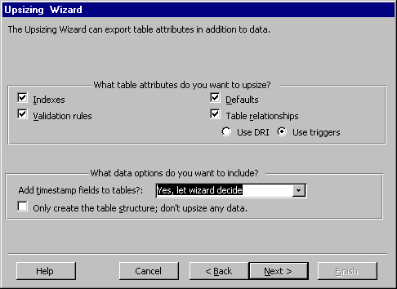

Slide 48
